Slide 2
PSALM 126
REORIENTATION

Slide 3
Psalms of Ascent
‎Psalms 120-134

Slide 4
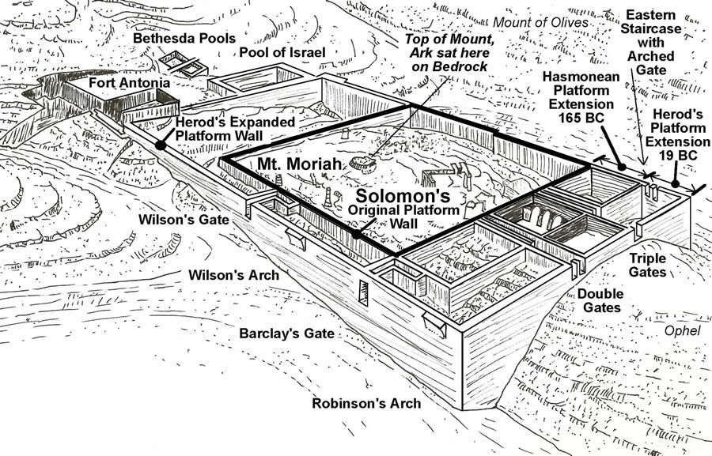

Slide 5
When the Lord restored the fortunes of Zion, we were like those who dreamed. Our mouths were filled with laughter, our tongues with songs of joy.
Psalm 126:1-2a

Slide 6
Then it was said among the nations, “The Lord has done great things for them.”
Psalm 126:2b

Slide 7
All the people gave a great shout of praise to the Lord, because the foundation of the house of the Lord was laid. But many of the older priests and Levites and family heads, who had seen the former temple, wept aloud when they saw the foundation of this temple being laid, while many others shouted for joy. No one could distinguish the sound of the shouts of joy from the sound of weeping, because the people made so much noise. And the sound was heard far away.
Ezra 3:11b-13

Slide 8
Babylonian Empire
Medo-Persian Empire
Greek Empire
Roman Empire
Fall of Israel
612—539 B.C.
539—333 B.C.
333—27 B.C.
27 B.C.—476 A.D.
70 A.D.

Slide 9
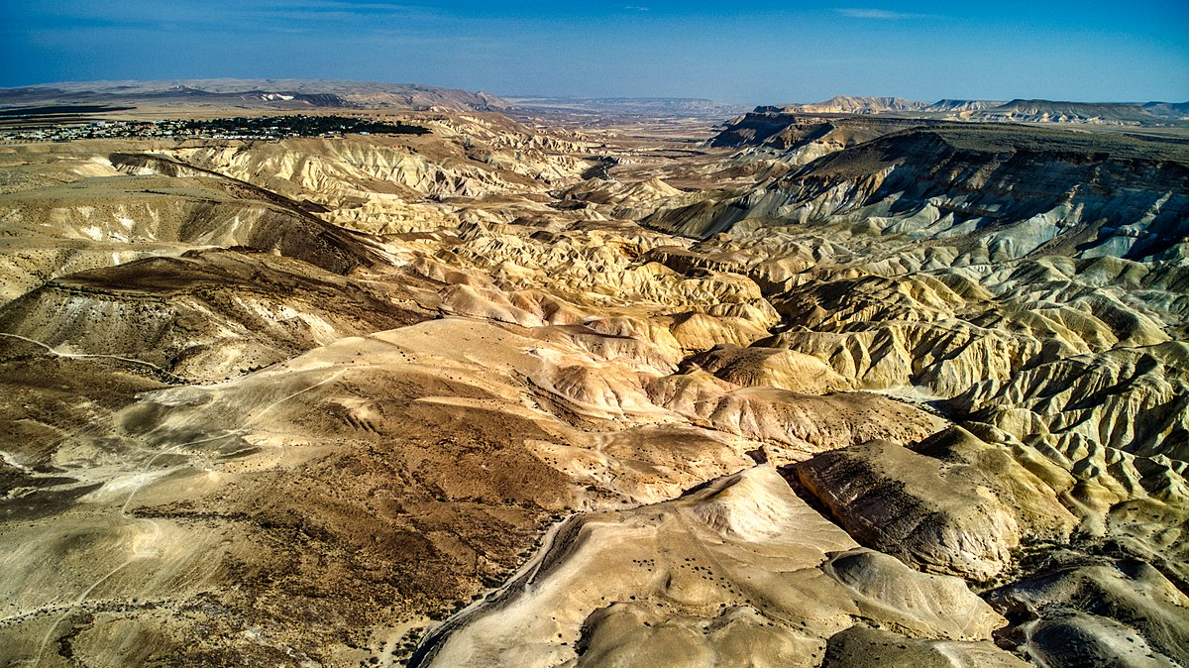

Slide 10
Those who sow with tears will reap with songs of joy. Those who go out weeping, carrying seed to sow, will return with songs of joy, carrying sheaves with them.
Psalm 126:5-6

Slide 11
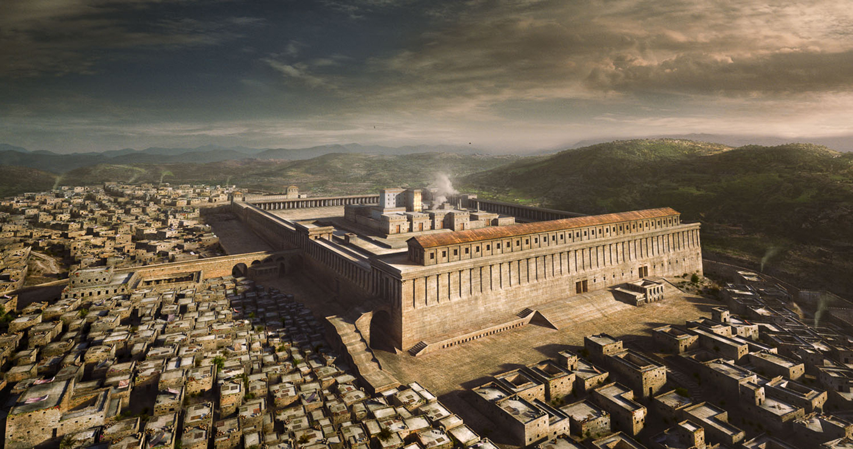

Slide 12
For here we do not have an enduring city, but we are looking for the city that is to come.
Through Jesus, therefore, let us continually offer to God a sacrifice of praise—the fruit of lips that openly profess his name.
Hebrews 13:14-15

Slide 13
But the fruit of the Spirit is love, joy, peace, patience, kindness, goodness, faithfulness, gentleness and self-control. Against such
things there is no law.
Galatians 5:22-23

Slide 14
